Slide 1
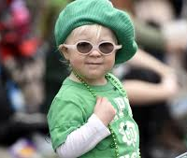
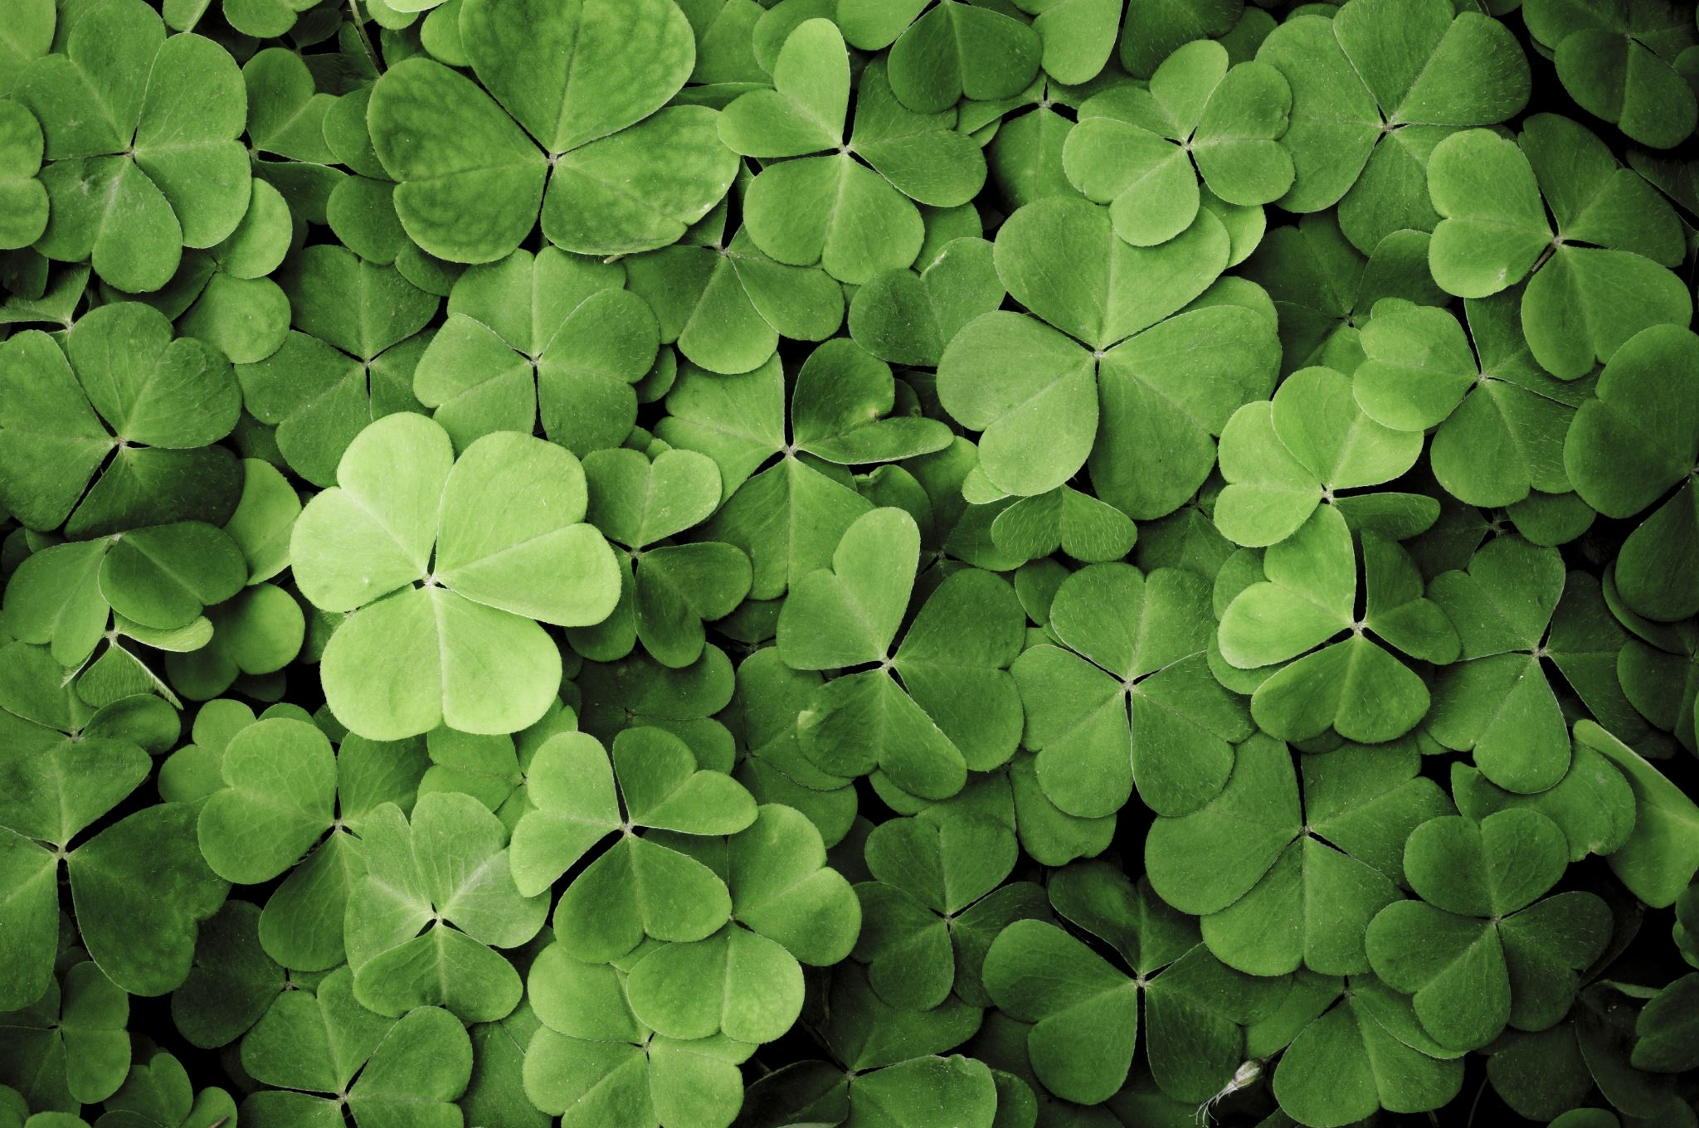
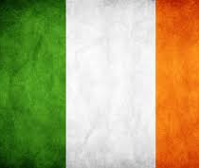
ST. PATRICK'S DAY

Slide 2
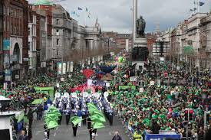
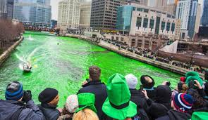
CELEBRATION
This holiday is celebrated on March 17 in different countries but the loudest celebrations are in the places where there are many Irish people. There organize parades and dye popular places green.
YT: https://www.youtube.com/watch?v=anjnvekFJGo

Slide 3
WHO WAS ST. PATRICK?
His real name is Maewyn Succat. He was born in 385 in Britain. Until he was 16 he thought that he's a pagan. At the age of 16 he became a slave. When he was released from captivity, he started to study in monastery for 12 years and then became a bishop. Also he converted many pagans by using pagan symbols but he changed their meaning and application
YT: https://www.youtube.com/watch?v=xOqWT2tk9Js

Slide 4
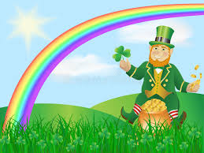
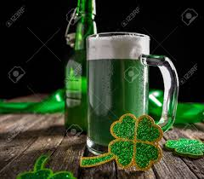
SYMBOLS
SHAMROCK BEER
SHILLELAGH LEPRECHAUN

Slide 5
LEGENDS
- St. Patrick used his shillelagh to throw the snakes out from Ireland.
- He used shamrock to explain Christianity to the pagans.
- His walking stick turned into a tree.

Slide 6
LEPRECHAUN
According to the legends they were the dwarves, who guarded the pots of gold at the end of the rainbow.

Slide 7
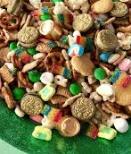
MEALS
Durning the celebration of St. Patrick's Day you can prepare:
- Irish stew
- shamrock-shaped cookies
- muffins with green cream
- some beer snacks
- green snacks
YT: https://www.youtube.com/watch?v=xpiI9q-eWe4

Slide 8
GREEN COLOR
- Green stripe on the Irish flag represent the Catholics
- St. Patrick used green shamrock to tell pagans about Holly Trinity
- Leprechauns are always depicted in green, legend says that if you don't wear green you will be pinched by them

Slide 9
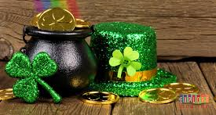
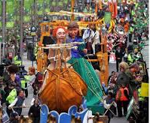
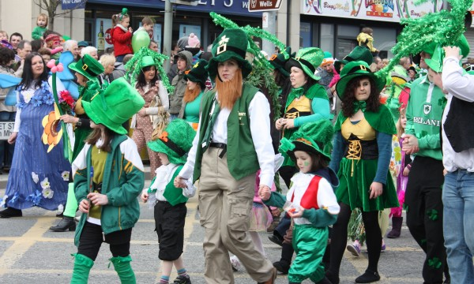
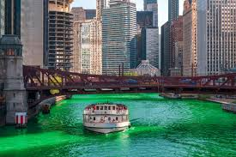

Slide 10
MADE BY: Aleksandra Pytel kl. VII B

